Slide 1
Linear Regression ML Model
By Amrita Panjwani

Slide 2
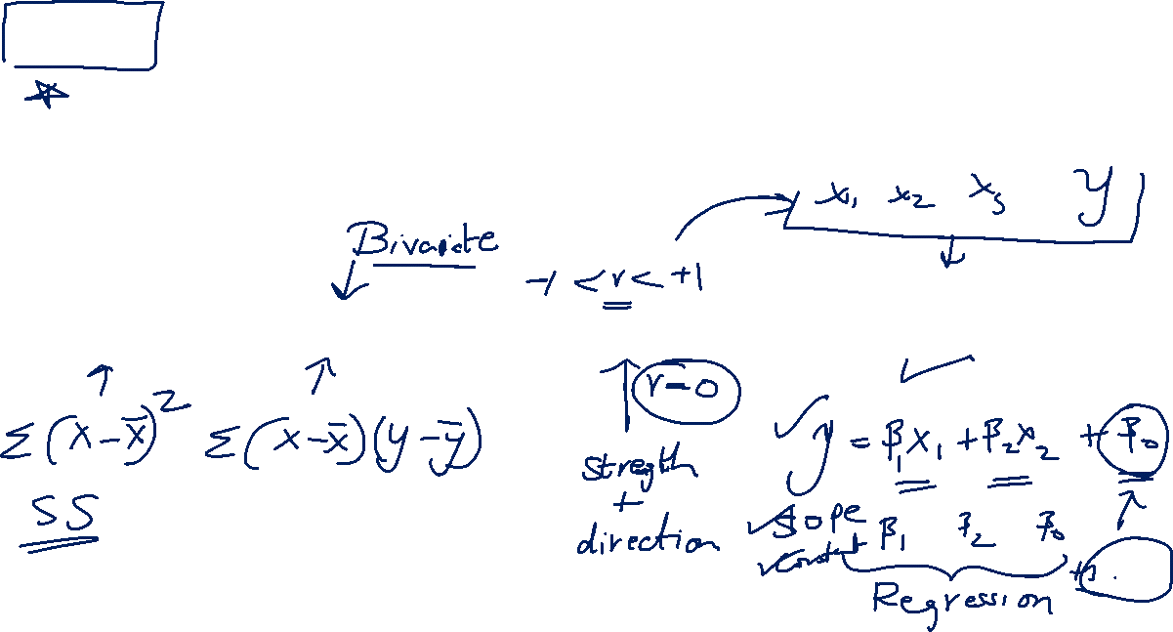
Linear Regression
It is a technique to model the relation between two types of variables by fitting a linear equation
Variance
Covariance
Correlation
Regression

Slide 3
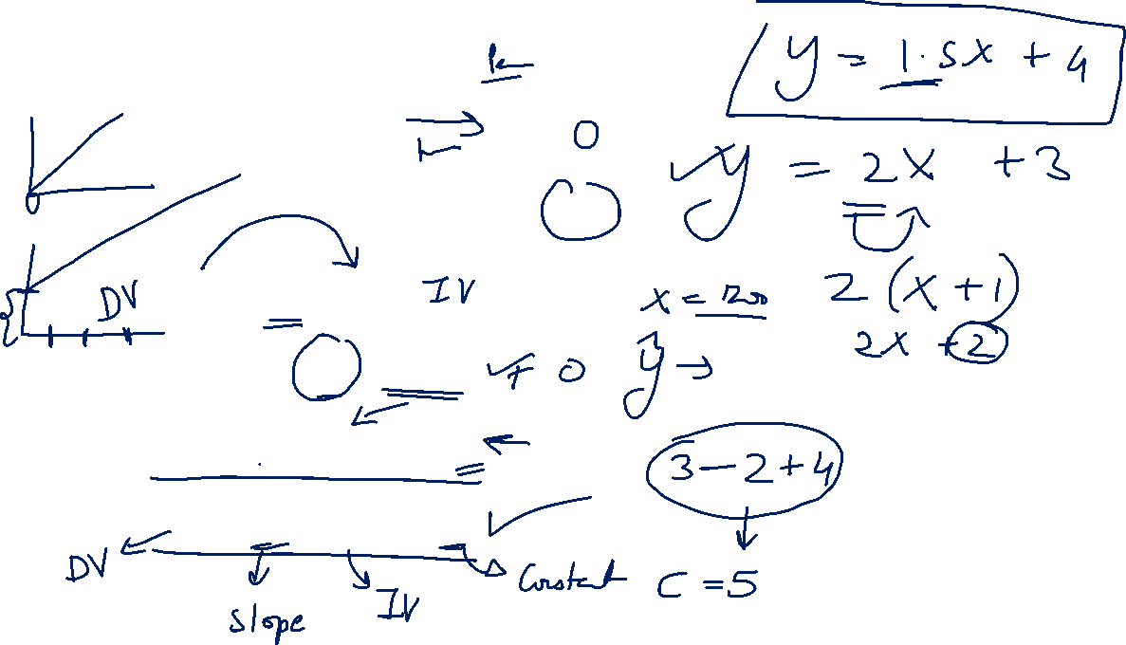
Example
House price is proportional to size

Slide 4
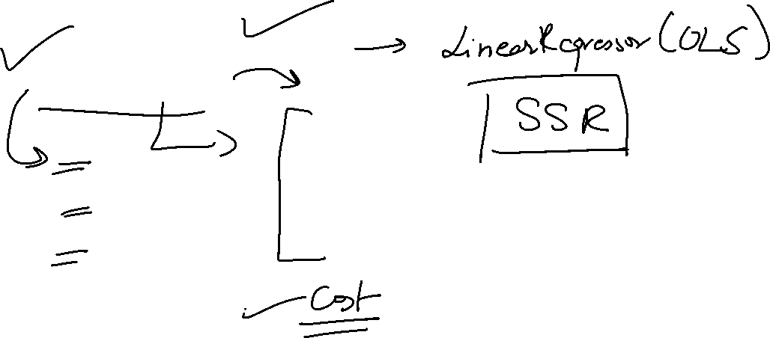
Algorithm for linear regression
Ordinary least square (OLS)
Gradient descent

Slide 5
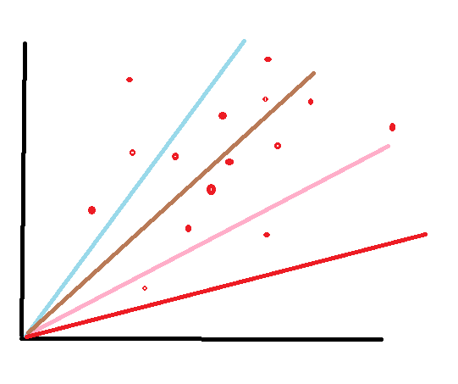
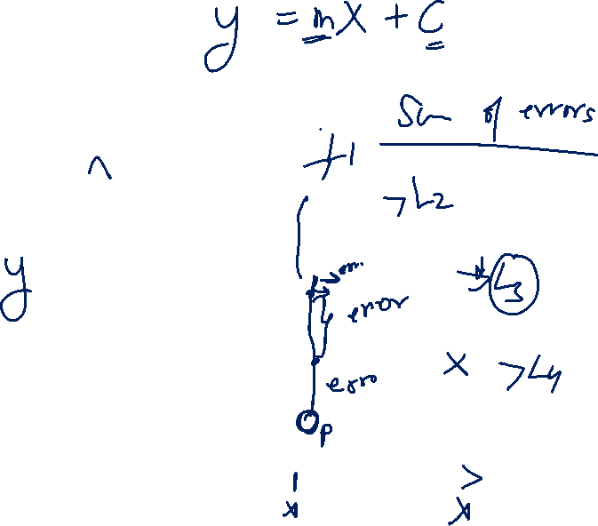
Ordinary Least Square
There can be multiple lines that can be used to represent the set of data values
How to decide which is the best line?

Slide 6
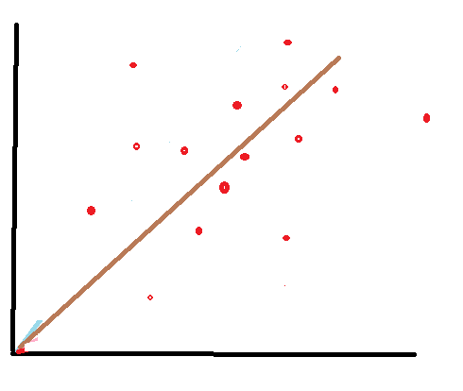

The line with maximum points around it seems to be the best fit.
The closest the points are to a line, the better fit is that line.
This implies the distance of points from that line is important

Slide 7
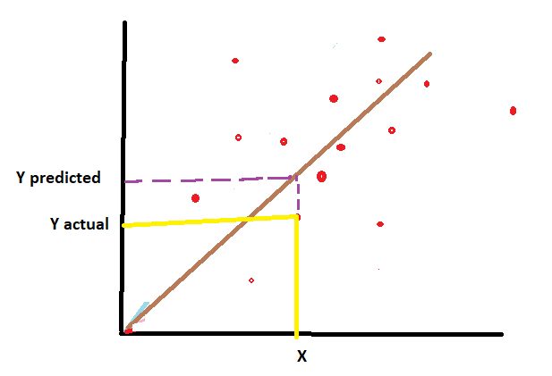
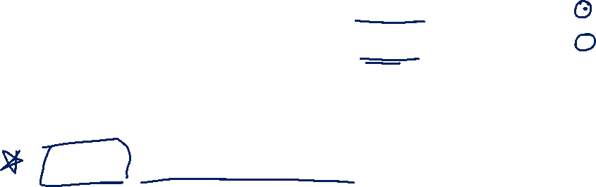
So suppose at point X the value Y is denoted by Y actual.
Now the corresponding value on the line is denoted as Y predicted
The difference in these two Y values is called error or residual.
Residual = Y actual – Y predicted

Slide 8
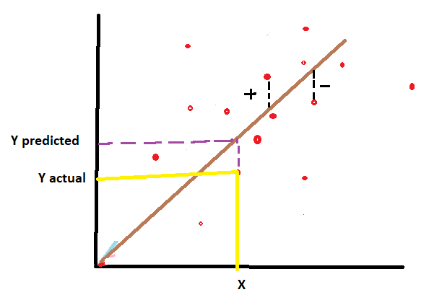
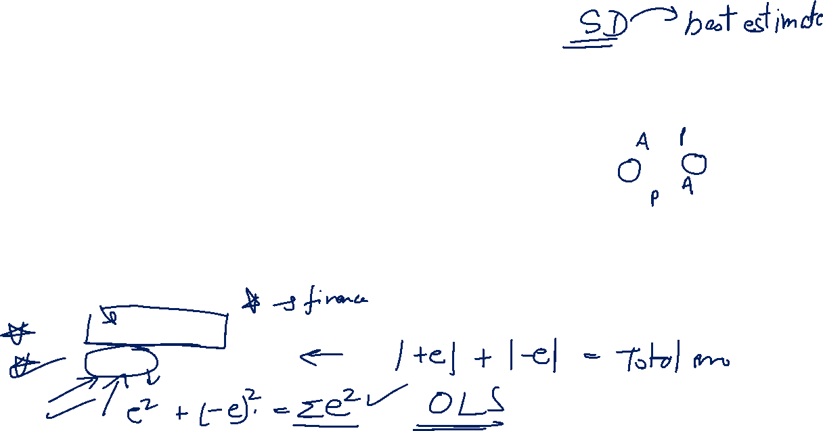
Since some points are above the line so the residual would be positive and some points are below the line so the residual would be negative.
Hence when total residual is calculated it does not give the true picture due to negative signs.
There are two ways to remove this negative sign:
Find absolute value of residual
Find square of each residual

Slide 9
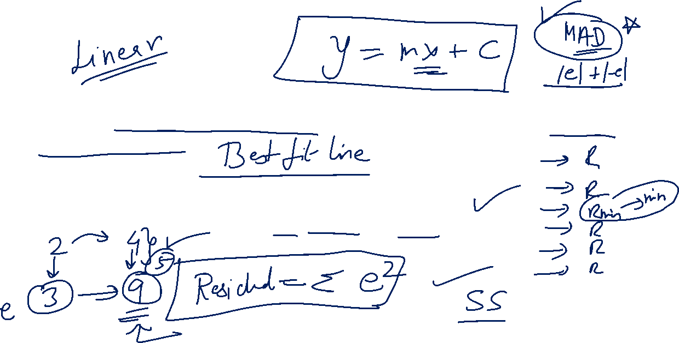
So the concept underlying linear regression model is to obtain a line that has least sum of square of deviations. Hence it is called ‘Ordinary Least Square( OLS)’

Slide 10
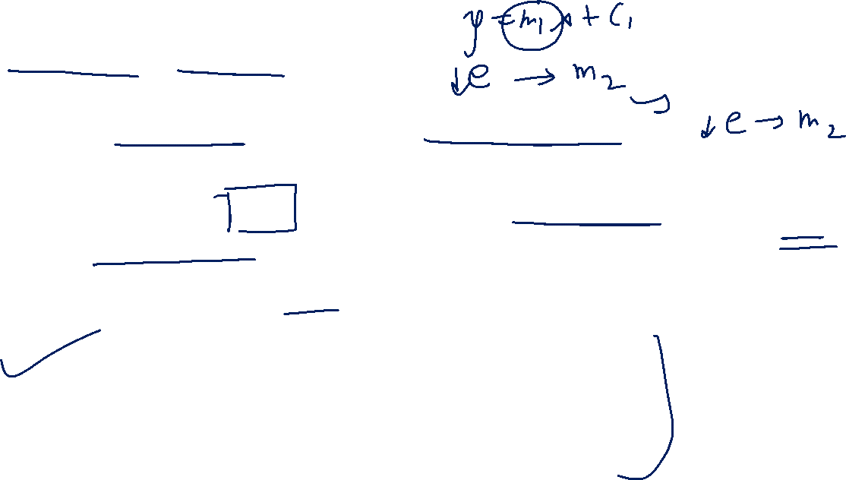
Gradient Descent
It is an optimization algorithm and it works step-wise.
The aim is to decrease the error step-wise.
In this algorithm , error is considered as a cost function.
Hence minimizing the cost function is the final goal.
Error is also denoted as SSR (Sum of squares of residuals)

Slide 11
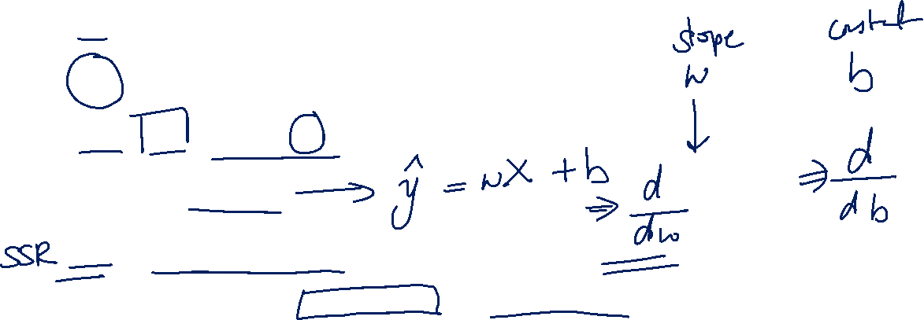
Y = denotes actual value of response variable
Recall the concept of minimization from differentiation.
To find minima differentiate the equation with respect to slope and then with respect to the constant value

Slide 12
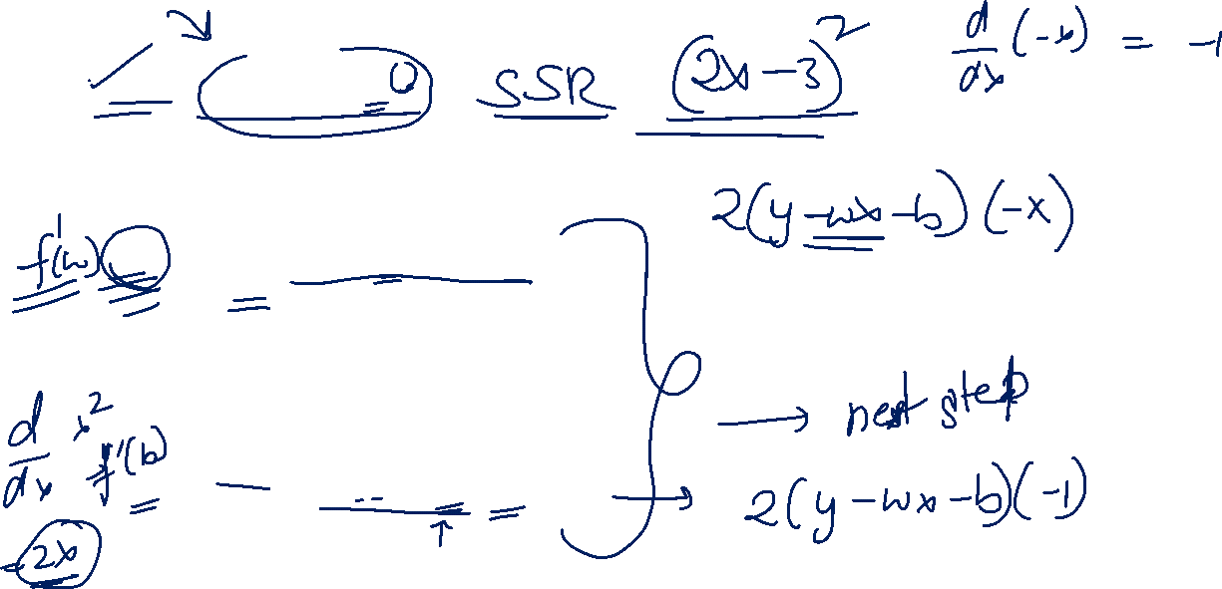
Differentiate the equation w.r.t w
Differentiate the equation w.r.t b
Equate both these equations to 0 , to get the first set of values of slope and constant

Slide 13
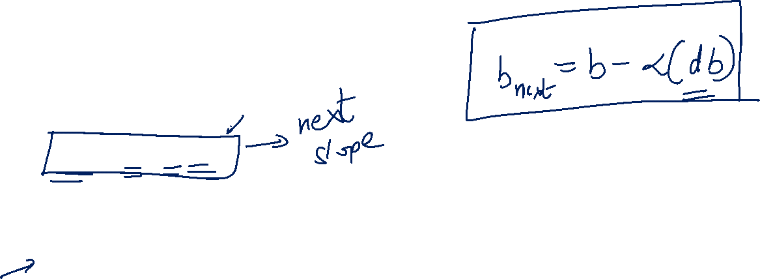
Next slope is given as:
Next slope = current slope – learning rate ( first derivate of slope)
Learning rate is a value that helps decided about the next slope. The curve of cost function is a U curve. So learning rate helps us decide the right amount of jump from previous slope to next slope such that the minima is reached.
A large value of learning rate may result in missing the minima, whereas very small value of learning rate may lead to increase in number of steps and may become way too complex.

Slide 14
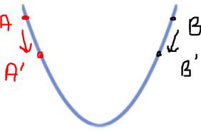
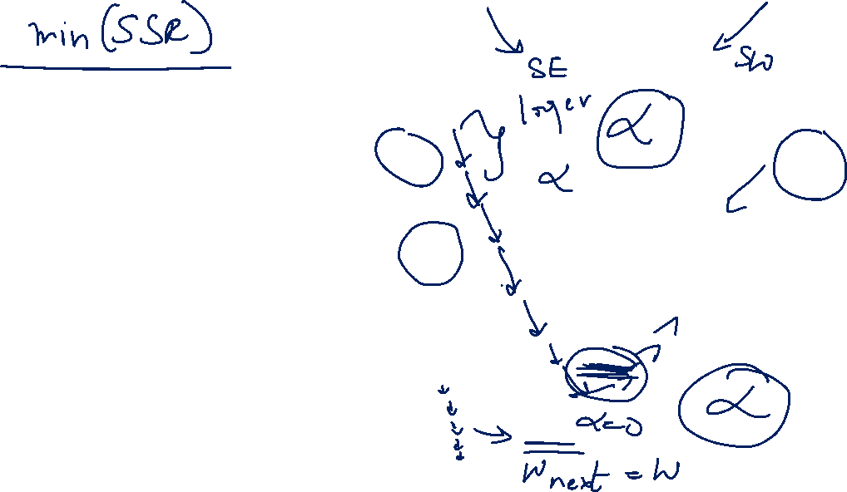
Here if the slope point is A, to reduce the cost , we move to point A’
And if the slope point is B , to reduce cost , we move to point B’
But if the slope is at point C, since it is the minima, no change in slope would be required.

Slide 15
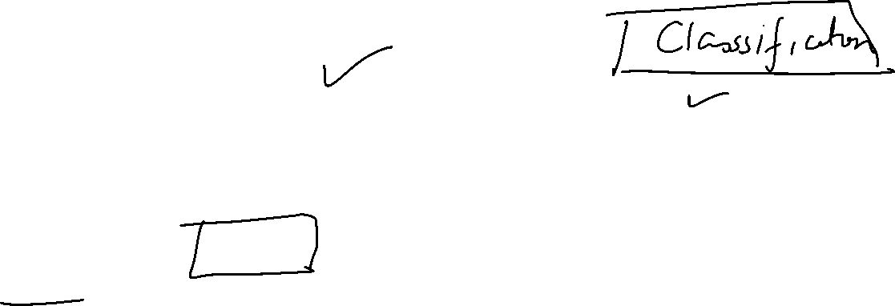
Evaluation Matrix
For each model there are different parameters used to evaluate the performance of the model.
In case of linear regression model the parameters of evaluation are:
MAE
MSE
RMSE
R square
Adj R square

Slide 16
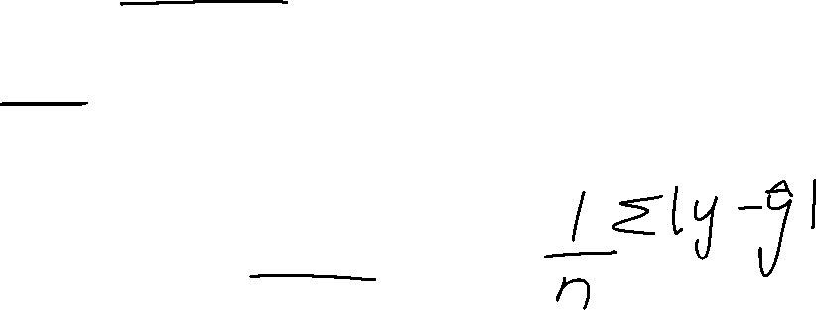
Mean Absolute Error
MAE is defined as the mean of absolute errors of the actual response values from the predicted response values.

Slide 17
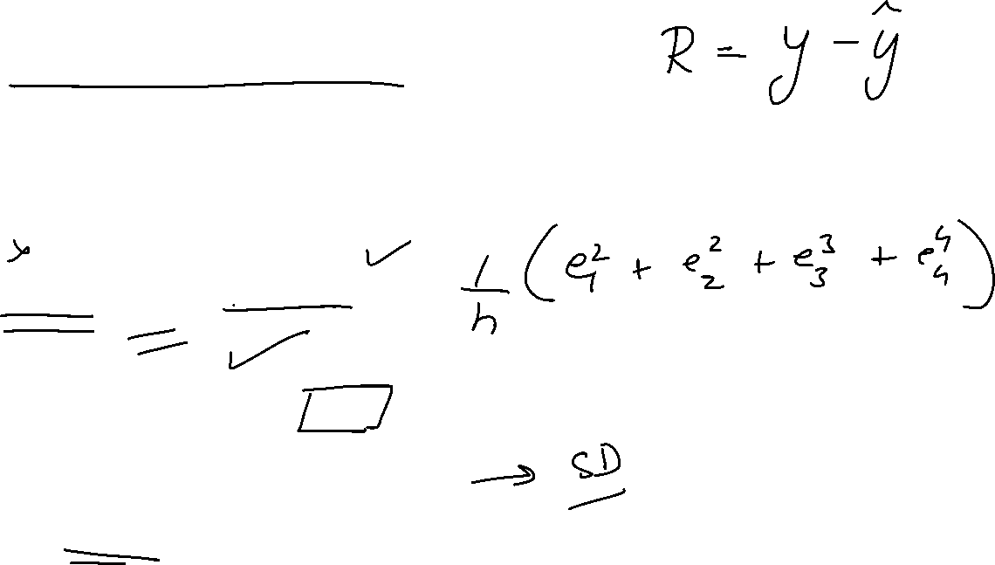
Mean squared error (MSE)
Mean squared error takes the mean of squared deviations of the values
Root Mean squared error takes the square root of MSE

Slide 18
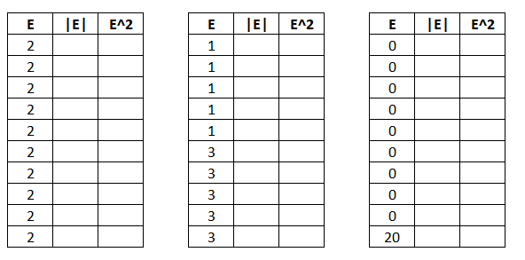
Example

Slide 19
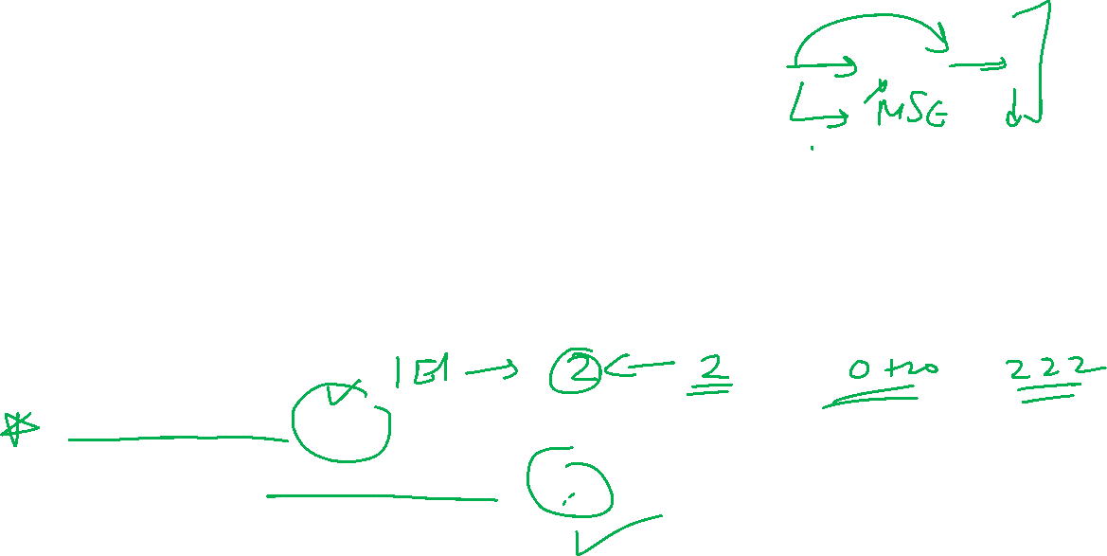
Observations
MAE value remains same no matter whether the original error values are same or highly varying.
RMSE on the other hand seems to be highly sensitive to the variation in the error values.
Conclusion: two parameters to decide which evaluation parameter to use:
Interpretability: MAE > RMSE > MSE
Sensitivity to extreme variations: MSE > RMSE > MAE

Slide 20
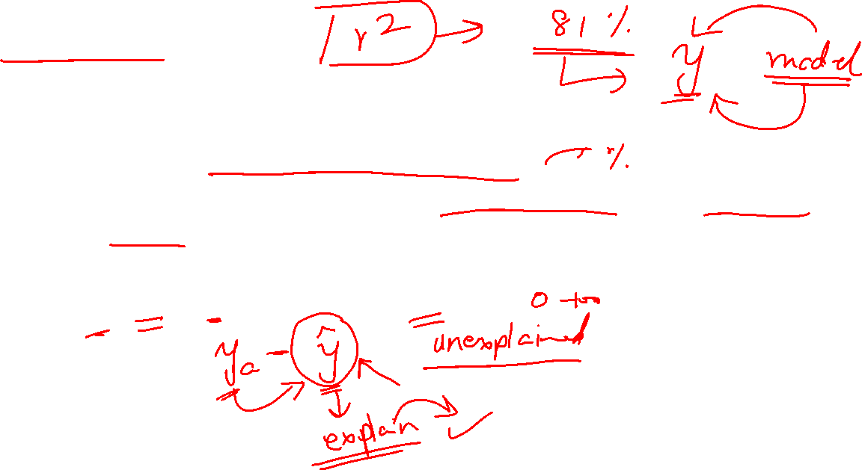
R square
The square of correlation coefficient is called R square.
It is also called ‘coefficient of determination’
R square tells about the percentage of variation in Y that is explained by the model. If more percentage of changes in Y can be explained by the model , that the model is considered to be a good fit.
Since -1 < r < +1 , this implies 0 < R2 < 1

Slide 21
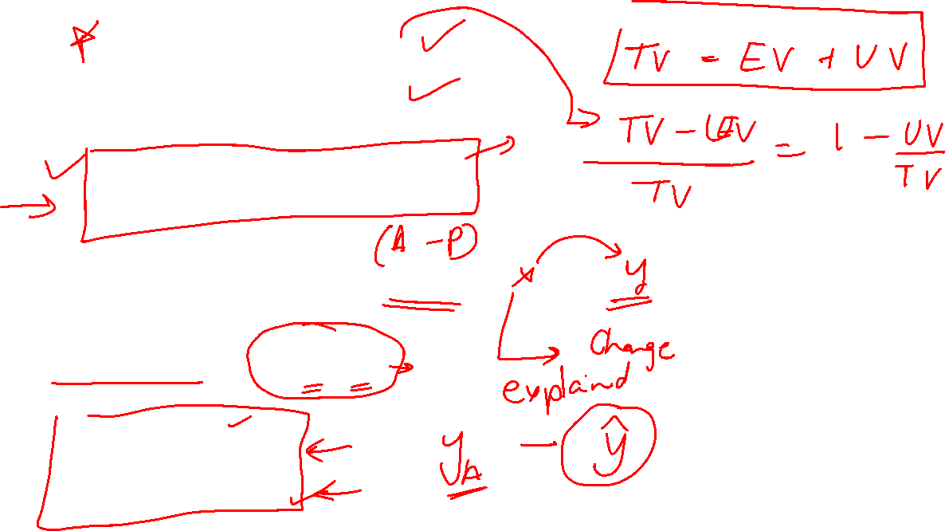

Slide 22
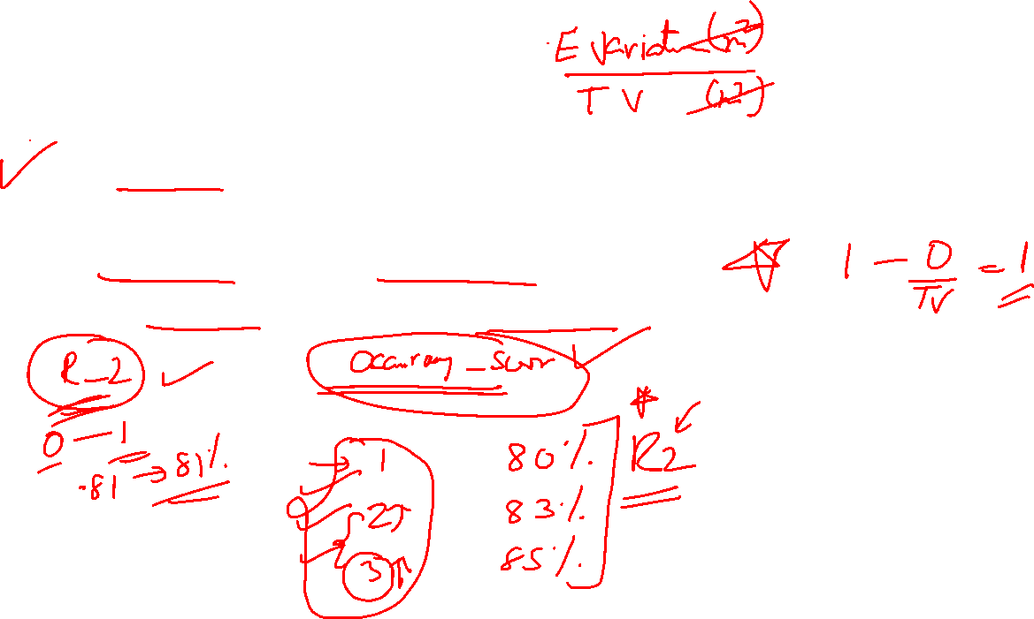
Interpretation of R2
R2 is a unitless summary of the linear associated of predictor variables with the response variable
If the residuals are 0 , then R2 is 100% (best ideal fit)
A higher R square value indicates a better fit

Slide 23
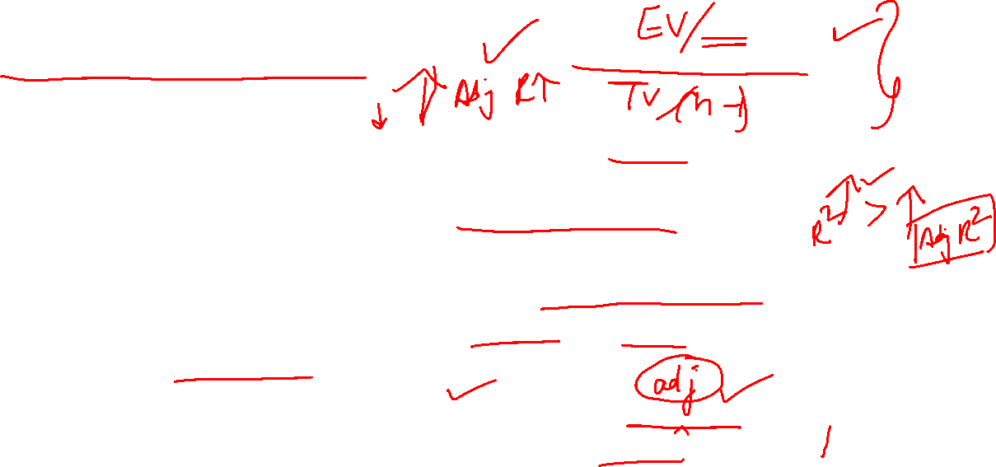
Adjusted R square
In a model , when the predictor variables are increased, this causes the R2 value to increase implying that increasing the count of variables leads to a good model, which is not true.
Hence when the number of variables are increased, a better measure to evaluate the model’s performance is Adjusted R square.
In adjusted R square , the value of R square is adjusted for the number of predictor variables.
Now as the variable count increases, the value of R square will increase only when the added variable really adds to the mode’s explanation power.

Slide 24
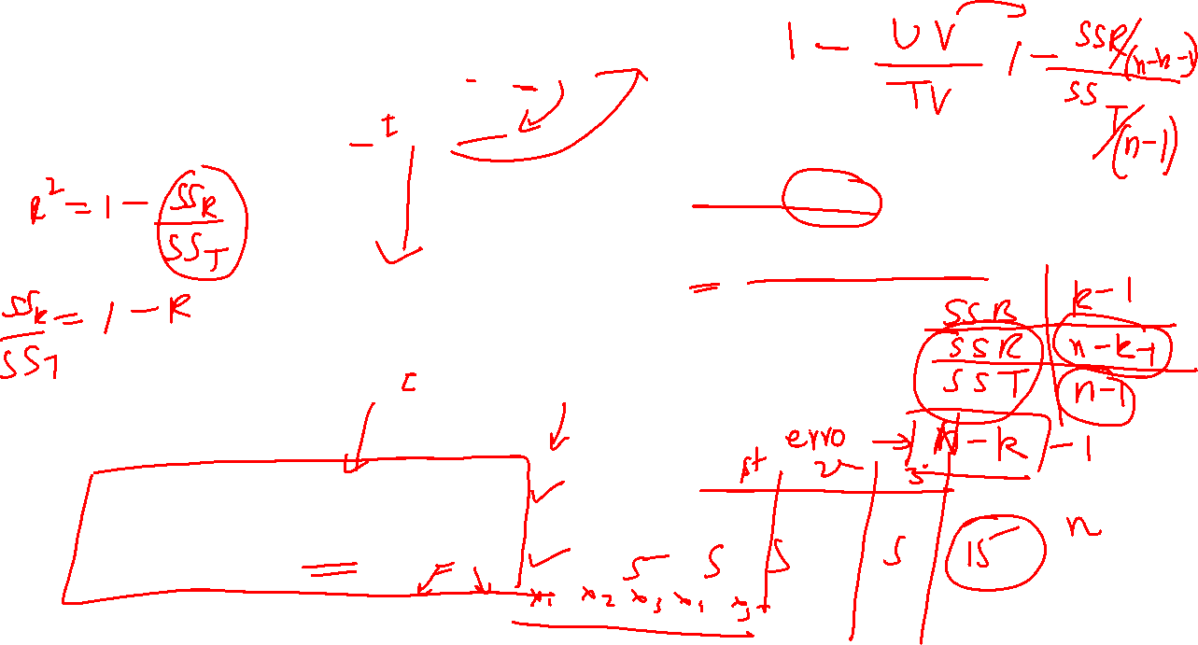
df residual = n –k
df total = n – 1
K = number of predictor variables
n = number of observations

Slide 25
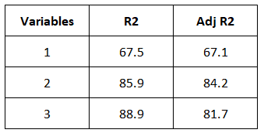
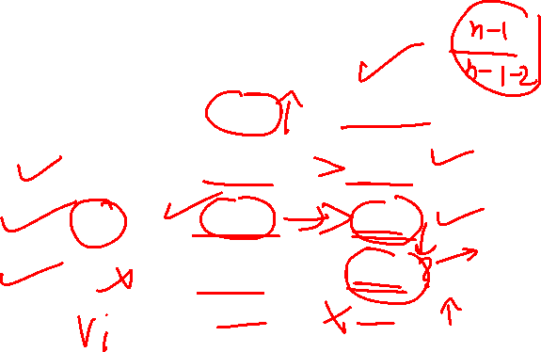
Example
As the number of predictor variables are increased from 1 to 2, the value of R2 increases and the value of Adj. R2 also increases.
As the number of predictor variables increase from 2 to 3, the value of R2 increases, but the value of adj. R2 falls down, this indicates that increasing the next variable is NOT a good idea.

Slide 26
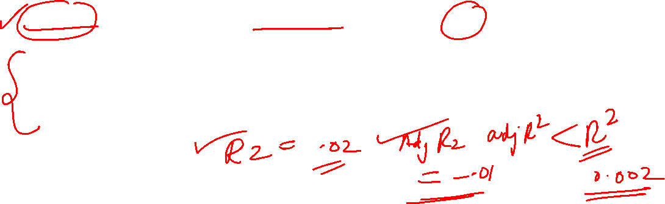
Observations
When there are multiple variables in the model, Adj.R2 is a better measure to evaluate the model
The value of Adj.R2 is always less than R2
Adj. R2 can be sometimes negative only when R2 is very close to 0
Interpretation of adj.R2: If the added variable does not contribute to the overall model, adj.R2 penalizes the value of R2 and hence the adj.R2 value shows the true effect of the added variable.

Slide 27
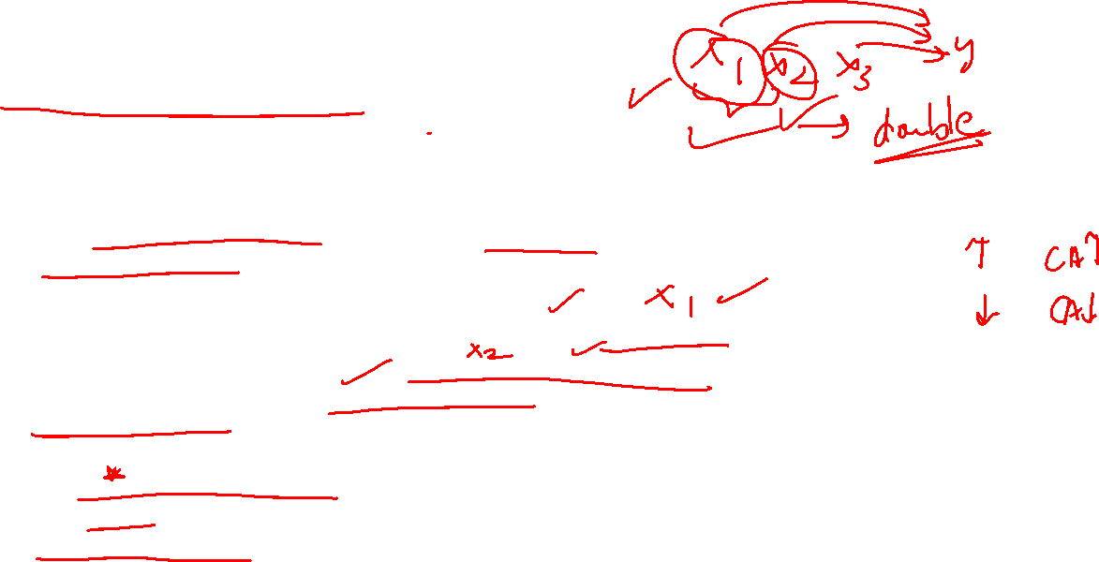
Multicollinearity
In real life, when many independent variables are involved in the model creation to help predict the output variable, there may be a chance that any two independent variables are correlated. This is called multicollinearity.
For example: in housing price model, if say carpet area is high, this also implies that there would be more number of rooms. So these two independent variables imply each other. And hence this may influence the resultant model.
Models are always built on the assumption that all the predictor variables are independent on each other, if this assumption is NOT true it results in a less reliable model. Hence it is important that there should be no multicollinearity.

Slide 28
How to detect multicollinearity
Visualization: Use heatmap
Statistical measure: Use correlation matrix
Statistical measure: Variance inflation factor (VIF)
VIF tells how much the variance in the regression coefficient increases if the predictor variables are related. It is given by: VIF = 1/(1 – R2)
In a way it depicts the extent of multicollinearity. A value of 5 or above indicates high multicollinearity

Slide 29
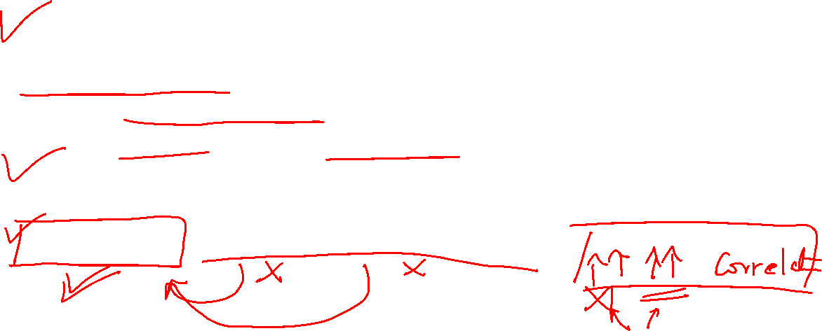
Methods to prevent multicollinearity
Drop off one of the related independent variables to eliminate the problem of multicollinearity
Feature engineering: Design the features in a way that the related variables do not harm the model.
Example: Carpet area and number of rooms are kind of related independent variables. A ratio can be taken as new feature in the model that depicts area per room.
Area per room = carpet area / number of rooms

